Slide 1

The Blessedness
of Being Broken PART 2
Matthew 5:4
Series: True Spirituality (2) How to live for Jesus moment by moment

Slide 2
Matthew 5:1-4 1Now when Jesus saw the crowds, he went up on a mountainside and sat down. His disciples came to him, 2and he began to teach them. He said: 3“Blessed are the poor in spirit, for theirs is the kingdom of heaven. 4Blessed are those that mourn, for they will be comforted

Slide 3
“Blessed” ~ to have the approval & smile of God on your life; to know the Spirit’s anointing.

Slide 4
“poor in spirit” ~ to recognize your real need for God and His forgiveness.

Slide 5
“the kingdom of heaven” = kingdom of God
Refers to the rule of the ungrieved Spirit in the life of the believer.

Slide 6
What does this mourning not mean?

Slide 7
Why are Christians to weep? The PURPOSE of mourning

Slide 8
The PURPOSE of mourning
A sense of our own sinfulness (Isaiah 6:5)

Slide 9
The PURPOSE of mourning
Effectual trials (James 1:2)

Slide 10
The PURPOSE of mourning
Exposed sin

Slide 11
The PURPOSE of mourning
Real repentance, obedience & our deliverance (2 Cor. 7:10)

Slide 12
2 Cor. 7:10 “Godly sorrow produces repentance that leads to salvation and leaves no regret, but worldly sorrow brings death.”

Slide 13
The POWER of the Spirit & Suffering

Slide 14
“I asked the Lord that I might grow in faith, and love, and every grace, Might more of His salvation know, and seek more earnestly His face.

Slide 15
'Twas He who taught me thus to pray, and He, I trust, has answered prayer; But it has been in such a way as almost drove me to despair.”

Slide 16
“I hoped that in some favoured hour at once He'd answer my request; And by His love's constraining power, subdue my sins, and give me rest. ”

Slide 17
“Instead of this, He made me feel the hidden evils of my heart, And let the angry powers of hell assault my soul in every part. ”

Slide 18
"Lord, WHY is this?" I trembling cried, "Wilt Thou pursue Thy worm to death?" "'Tis in this way," the Lord replied, "I answer prayer for grace and faith."

Slide 19
Job 42:5-6 "My ears have heard of you, but now my eyes have seen you. Therefore I despise myself and repent in dust and ashes.”

Slide 20
1 Peter 1:6-7 "In this you greatly rejoice, though now for a little while you may have had to suffer in all kinds of trials. These have come so that your faith - of greater worth than gold, which perishes even though refined by fire - may be proved genuine and may result in the praise, glory and honour when Jesus Christ is revealed.”

Slide 21
The PROMISE to those who mourn
1. The basis of their comfort is forgiveness.

Slide 22
The PROMISE to those who mourn
2. They will be comforted.

Slide 23
The PROMISE to those who mourn
3. To those who are not yet Christians, mourning is meant to lead you to Jesus

Slide 24
Please contact us if you have responded to the Lord
or need prayer or counselling. Please contact Pastor Paul or email:
coffeechat101@gmail.com
Notices

Slide 25
Church Services are open!!
09:00 & 18:00
Please remember to pre-register. Links are in the Pulse & WBC WhatsApp. or contact the office for assistance on 012-347 0171
Services will continue to be live streamed
on YouTube
Notices

Slide 26
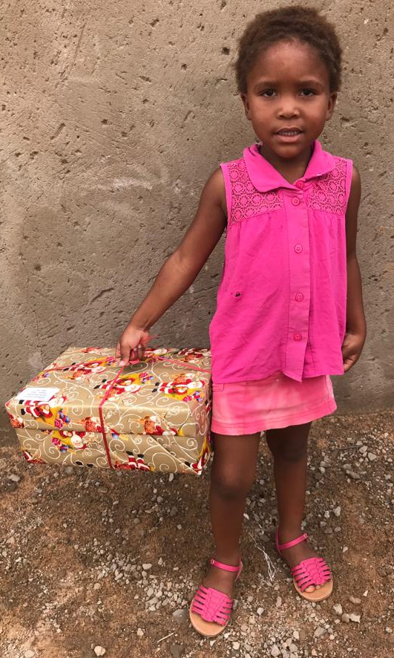
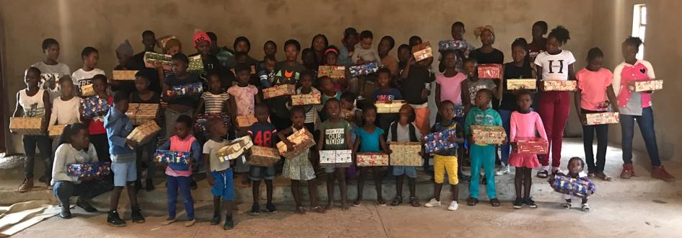
Christmas bags 2020 Missions Project
Four communities, 190 Christmas bags, R160 per bag, raise R30 400 in total
To MOST of these children it is the only gift they receive each year, the only gift that has their name on it.
We are asking for donations for the Christmas bags. We will do the shopping for you. EFT donations can be made to our church account. Please mark your donation – ‘Christmas’.
France and Sophy Ngualo | Phake | Christ Baptist Church
Kgomotso and Mary Sebola | Spitspunt | Spitspunt Baptist Church
Christian and Claudia Rustoff | Stinkwater | Stinkwater Baptist Church
Bethesda Outreach Ministries | Hammanskraal | Children’s Village

Slide 27
October Thanks Giving Month Our focus will be with the Faith Promise. Please specify: Christmas Bags Project FP Missionaries *Please remember that this giving is apart from your tithe!!*
Notices

